Slide 1







Predicting Risky Healthcare Companies
Group 2:
Isaac Tan E
Aaren Ng
Law Qi Xue
Akshay Bryan
Justin Ryan Sy Yu

Slide 2




Agenda
01
02
03
04
Scope of Data Analysis
Independent Variables
Dependent Variables
Data Cleaning Steps
05
06
07
Findings & Case studies
Modelling
Limitations

Slide 3
Scope of Data Analysis

Slide 4


Sub-Industries
Code | Category | Description
3410 | Diversified | Refers to conglomerates or companies operating across multiple sectors within healthcare, pharmaceuticals, cosmetics, or medical equipment.
3420 | Cosmetics & Toiletries | Companies focused on beauty products, skincare, hygiene items, and personal care goods.
3430 | Ethical Drug Manufacturers | Companies producing prescription drugs regulated by healthcare authorities.
3440 | Medical, Surgical and Dental | Manufacturers and distributors of medical devices, surgical tools, dental equipment, and related supplies.
7040 | Drug Store Chains | Retail outlets specializing in pharmaceuticals, over-the-counter drugs, and health-related products.
8550 | Medical Services | (hospitals, clinics, outpatient services, senior care facilities, and other healthcare providers focused on delivering medical care and services.

Slide 5
2. Independent Variables

Slide 6

Independent Variables
Current Ratio | Industry | Year-on-Year Change in Net Income
Debt-to-Equity Ratio | Restated Later | Year-on-Year Change in Cash Flow
Return on Equity | Overvaluation | Year-on-Year Change in Total Debt
Profit Margin | Auditor Opinion | Year-on-Year Change in Research & Development
Inventory Turnover | Property, Plant and Equipment | Year-on-Year Change in Accounts Receivable Days
Z-Score | Brands, Patents, Net | Year-on-Year Change in Market Cap
Working Capital | Year on Year Change in Revenue
Notes:
Current Ratio
The current ratio (current assets / current liabilities) measures a company’s short-term debt payment capacity. A high ratio may indicate inflated assets, masking financial distress. Enron's 2001 collapse is a prime example, where falsified cash and receivables inflated its ratio, hiding its insolvency (History.com, 2019).
Debt-to-Equity Ratio
The debt-to-equity ratio (total debt / equity) reflects leverage, with unusually low ratios potentially hiding debt. In 2002, WorldCom misclassified $11 billion in expenses to lower its debt-to-equity ratio, revealing a massive debt burden when corrected (BBC News, 2002).
Return on Equity (ROE)
ROE (net income / equity) gauges profitability. A high ROE can signal fabricated profits, as seen in WorldCom's fraudulent capitalizing of expenses, inflating ROE and misleading investors (Investopedia, n.d.).
Profit Margin
Profit margin (net income / revenue) shows the percentage of revenue converted to profit. High or inconsistent margins can signal overstated revenues. HealthSouth's 2003 fraud, which fabricated $2.7 billion in earnings to report a 15% margin, eventually collapsed when actual cash flow didn’t match reported profits (CNN Money, 2003).
Inventory Turnover
Inventory turnover (COGS / average inventory) measures inventory management. Low turnover could indicate inflated inventory. Enron had low turnover prior to its collapse, possibly manipulating inventory values (Investopedia, n.d.).
Z-Score
The Z-Score combines financial ratios to predict bankruptcy risk, with low scores suggesting financial distress. Lehman Brothers concealed $50 billion in debt to mask deteriorating Z-Scores before its 2008 collapse (NY Times, 2010).
Working Capital
Working capital (current assets - current liabilities) signals short-term financial health. Fabricated assets can inflate working capital. Parmalat's 2003 fraud involved faking $5 billion in assets, concealing its insolvency (BBC News, 2004).
Industry
Industry norms provide context for evaluating metrics. Significant deviations can signal manipulation. Wirecard’s fintech fraud exploited industry complexity to hide fraudulent practices (Rubio, 2020).
Restated Later
Restatements often indicate fraud. Toshiba's 2015 scandal involved restating $1.9 billion in inflated profits (Pfanner, 2015).
Overvaluation
Overvaluation occurs when market prices exceed fundamental value, often through inflated metrics. Theranos' massive market valuation masked fraudulent activities despite lacking viable technology (U.S. Department of Justice, 2022).
Auditor Opinion
Auditor opinions assess the reliability of financial statements. Enron’s 2001 collapse shows how unqualified opinions delayed fraud detection, with Arthur Andersen ignoring hidden losses (History.com, 2019).
Property, Plant, and Equipment (PPE)
PPE accounts track operational assets, with overstatement potentially inflating values and profitability. WorldCom’s 2002 scandal involved misclassifying $3.8 billion in expenses as PPE, misleading investors (SEC, 2002).
Brands, Patents, Net
Intangible assets can be inflated to boost reported assets. AOL Time Warner’s 2002 accounting issues involved overstating intangible assets by $54 billion during a merger (NY Times, 2002).
Year-on-Year Change in Revenue
Large revenue increases may indicate fabricated sales or improper recognition. Enron’s 700% revenue growth between 1999-2000 was driven by fictitious trades (History.com, 2019).
Year-on-Year Change in Net Income
Inconsistent net income growth could indicate manipulation. HealthSouth’s 2003 fraud involved reporting 20-30% annual growth through fabricated financial entries (CNN Money, 2003).
Year-on-Year Change in Cash Flow
Diverging cash flow and profit trends may signal manipulation. Luckin Coffee’s 2020 fraud involved reporting high revenues without corresponding cash flow (SEC, 2020).
Year-on-Year Change in Total Debt
Rapid debt increases can signal efforts to conceal financial problems. Lehman Brothers concealed $50 billion in debt through "Repo 105" transactions before its 2008 collapse (NY Times, 2010).
Year-on-Year Change in R&D
Fluctuations in R&D spending can signal earnings manipulation. Valeant Pharmaceuticals reduced R&D spending while reporting enhanced earnings, leading to a scandal (Transparently.ai, 2021).
Year-on-Year Change in Accounts Receivable Days
Rising receivable days may indicate fabricated revenue. Satyam Computers showed increasing receivable days before its fraud was exposed (Jaiswal, 2025).
Year-on-Year Change in Market Cap
Extreme market cap fluctuations can reflect artificial valuations from fraudulent reporting. Wirecard’s 300% market cap surge between 2015-2018 was based on fabricated profits, leading to its collapse in 2020 (Reuters, 2020).

Slide 7
3. Dependent Variable Selection

Slide 8


Dependent Variable Selection
Current Ratio
Indicates company’s liquidity and ability to pay off short-term liabilities. A healthy ratio would be in the range of 1 and 5.
Manipulation of current ratio by companies wrapped in financial distress could suggest underlying issues regarding liquidity through artificial boosting of cash or receivables like in the case of Enron in 2001

Slide 9
Dependent Variable Selection
Debt-to-equity
Calculates a company’s financial leverage by comparing its total debt to its shareholders’ equity
Companies with high debt-to-equity ratios are often associated with financial distress and so is the case in WorldCom’s collapse in 2002

Slide 10
Dependent Variable Selection
Financial account restatements
Flagged when the auditor requires a company to restate the figures on its financial statements due to misstatements or accounting errors.
An indicator of lack of internal controls and lapses in accounting records
Overvaluation
Happens Market Valuation of shares exceeds the book value of the company’s Net Assets less Retained Earnings.
A potential sign of positive investor sentiment to the company due to aggressive earnings projections (e.g. NVIDIA before Deepseek and Tesla before Trump)

Slide 11
4. Data Cleaning Steps

Slide 12

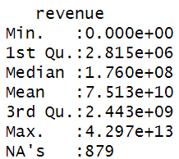
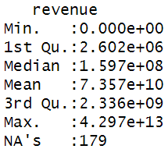

Winsorisation
Purpose: To handle missing data our dataset.
How: By using replacing values below 5th percentile with the value at 5th percentile and replacing values above 95th percentile with the value at 95th percentile, and then computing winsorized mean.
We will use winsorized mean to fill the missing data
Managed to fill 38500 missing data with winsorised mean. After winsorisation, we filled the remaining NA with 0.
Notes:
We use winsorization to fill the missing data with computed winsorised mean and managed to fill around 38k missing data.
Note: this is done because we want to minimise the outliers effect on the computed mean

Slide 13
5. Modelling

Slide 14
Prediction Approach
Debt-to-Equity
Current Ratio
Overvaluation
Restatements
XGBoost
XGBoost
LASSO Regression
Random Forest Model
If a company is marked as positive in all 4 models predictions, it will be flagged for further investigation.
Notes:
We will be building 4 models to predict risky indicators.
Our approach incorporates a multi stage filtering pipeline where each of these 4 models we built, will help to filter out risky companies at each stage.

Slide 15

Model Validation
80% Training
Get Test AUC and Test Precision, Recall, Specificity from fitting Test data in model and choose best model.
Data A - 2019 to 2022
20% Testing
Get prediction of Data B using best model obtained from Data A training.
We split dataset into two sets, one is 2019-2022 and the other is 2023.
Data B - 2023
Notes:
next I'll go through how we validate our models. we will split the data into two with different time frames and build our models solely based on data A.
we will then decide best model by checking the test metrics like test AUC.
afterwards, we will fit dataB into the best model and get our predictions.

Slide 16
Model 1: Debt-to-Equity

Slide 17



Why Debt-to-Equity?
Flagging out companies with risky debt-to-equity ratio is crucial because it highlights financial distress or potential bankruptcy.
Valeant Pharmaceutical was a Canadian pharmaceutical company that focused on acquisition financed by debt rather than R&D. This business strategy has led to its downfall.
Valeant’s debt-to-equity ratio peaked at 5:1, which was nearly eight times that of other big pharma companies, such as Pfizer.
Subsequently, its stock price fell by 95% and it was left with $30 billion debt.
Valeant Pharmaceutical
Source: Lorenzetti, 2015
Notes:
from this case study, we can see that the debt to equity ratio was a telling sign that the company was not doing well financially.
note:
debt to equity ratio is an important indicator to point out risky companies.
Valeant was operating on an unsustainable business strategy which subsequently led to its downfall. this goes to show that

Slide 18

Industry | Debt-to-Equity Threshold
Drugs, Cosmetics, and Healthcare (3400) | 1.5
Diversified (3410) | 2.5
Cosmetics & Toiletries (3420) | 1.5
Ethical Drug Manufacturers (3430) | 2.5
Medical, Surgical & Dental Suppliers (3440) | 1.5
Drug Store Chains (7040) | 2.5
Medical Services (8550) | 2.5
Debt-to-Equity Industry Specific Threshold
We will mark company as having a risky debt-to-equity ratio if their debt-to-equity exceeds the threshold or when it is negative.
Notes:
we have different thresholds for different industries because we note that they might have different characteristics.
Industries that are less capital intensive have a lower threshold of 1.5.
while Industries that are more capital intensive or those that tend to leverage debt to fund business operations have a higher threshold of 2.5.
Additional:
Diversified: Conglomerates typically maintain higher leverage to support multiple business segments and finance strategic acquisitions.
3430: Pharmaceutical companies maintain higher leverage to fund substantial R&D investments
7040: Retail pharmacy chains often leverage debt to finance real estate expansion.
8550: Healthcare service providers often leverage debt to fund infrastructure development and operational requirements.

Slide 19
Model Performance
Model | Out-sample AUC | Out-sample Sensitivity/Recall | Out-sample Precision | Out-sample Specificity
Simple Logistic | 64.86% | 99.79% | 72.23% | 3.73%
Fixed Effect Logistic | 58.45% | 60.87% | 60.07% | 50%
LASSO | 64.55% | 99.83% | 71.98% | 2.49%
Random Forest | 94.72% | 80.19% | 84.67% | 94.21%
XGBoost | 92.92% | 93.34% | 92.47% | 80.91%
Notes:
XGBoost performed the best, taking every metrics into account and therefore, we chose XGboost for flagging out risky Debt-to-equity ratio.
Note:
We believe that avoiding false negatives is more important in our model because our model aims to identify risky companies and leaving out actual risky companies would be more problematic.
Therefore, we focused more on the recall rate which represents the total positive rate predicted. A higher recall rate means we are minimising false negatives and maximising true positives.
recall = TP/TP+FN
precision=TP/TP+FP
specificity=TN/TN+FP
While it’s possible that this model is overfitted, but given our 4 stages filtering approach, the additional noises or false positives are expected to be filtered out.

Slide 20
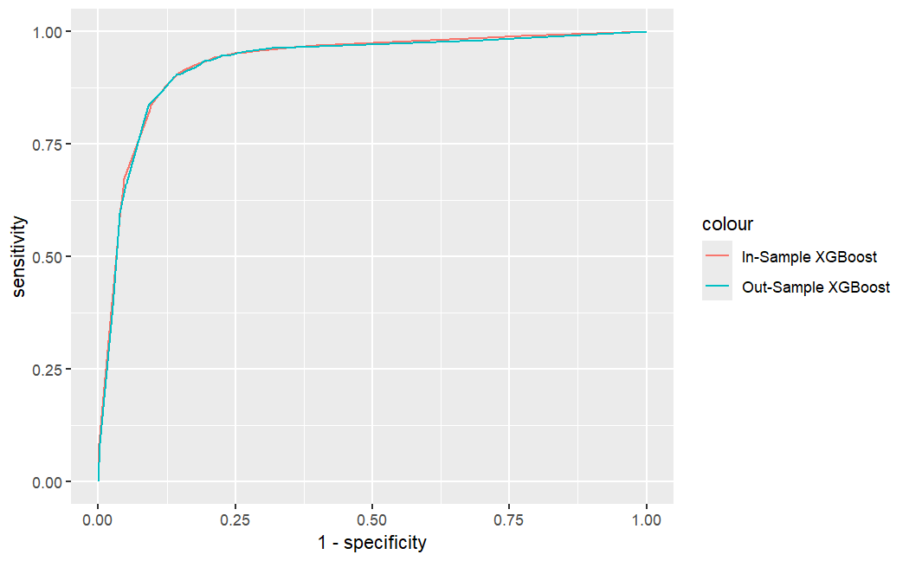
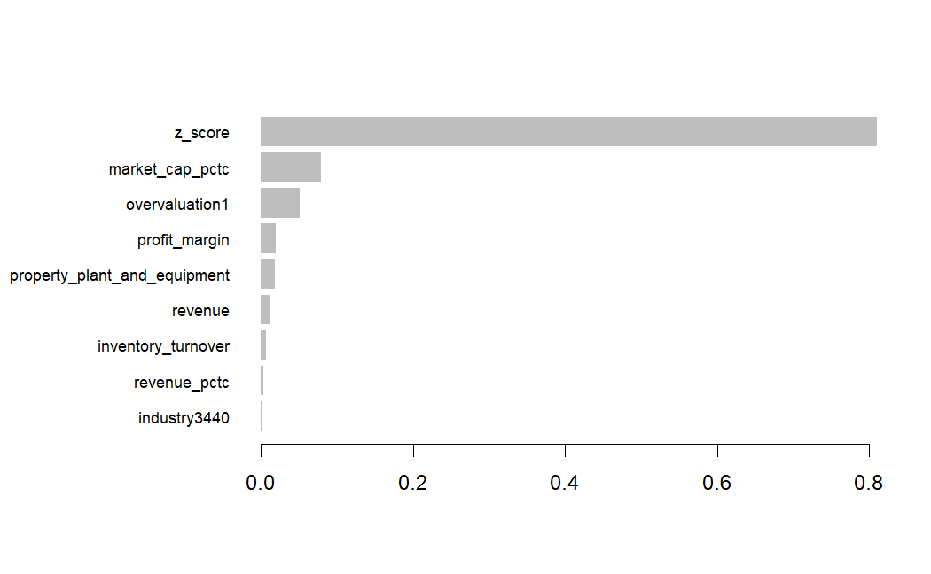
XGBoost Result
In-Sample and Out-Sample ROC Curves
XGBoost Importance Plot
Notes:
What does it mean to be on the top few variables of the XGBoost importance plot? it means that these features have a strong influence on the prediction as the model frequently uses these information and changing or
omitting these features would likely impact the prediction significantly.

Slide 21
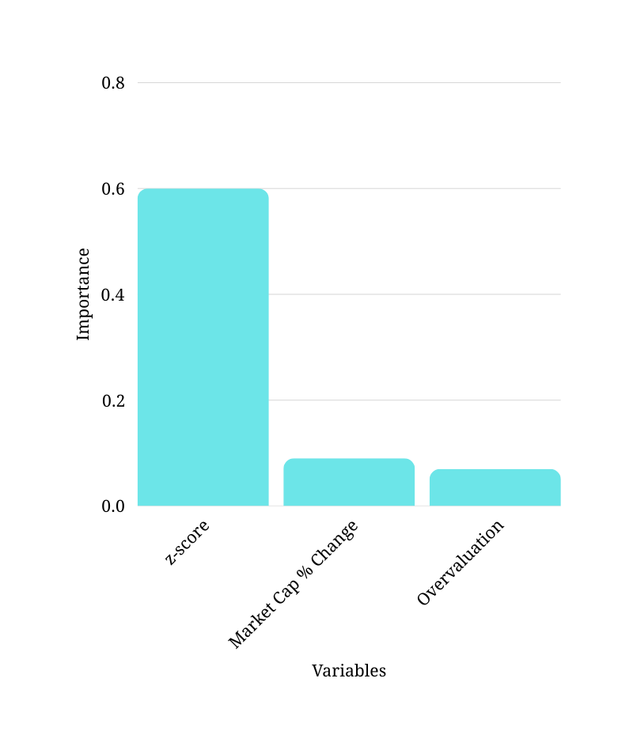
Ranking Importance
Top 3 variables
Z-score : Companies with lower Z-scores are likely to have higher debt-to-equity ratios, indicating higher bankruptcy risk.
Market Cap % Change: Declining market cap often prompts companies to increase debt financing when equity financing becomes less favorable due to fallen stock prices, increasing the debt-to-equity ratio.
Overvaluation : Overvalued companies may exploit their high valuations to take up debt at favorable terms, potentially creating unsustainable debt levels if the overvaluation corrects.
Notes:
So here, i'll be going through the top 3 important features flagged by XGBoost.
Additional:
market cap falls means stock prices fall. this make equity financing less attractive as the return on each equity sold is less.
Inventory Turnover - Companies with poor inventory management often require more working capital financing through debt, increasing their debt-to-equity ratio.
Property, Plant and Equipment - Asset-heavy companies with significant PPE typically use debt financing to acquire these long-term assets, leading to higher debt-to-equity ratios.

Slide 22
Model 2: Overvaluation

Slide 23
Why Overvaluation?
39%
Restatements leading to decrease in earnings led to a 39% loss in equity
in value related to decreased earnings after restatement
Market Capitalisation > Equity - Retained Earnings
Double
Correction
The firms in question continued to perform poorly after the restatement
to adjust for the overvaluation and loss of confidence
Source: Marciukaityte & Varma, 2008
Notes:
Overvaluation is determined as a binary outcome variable based on this equation, so this implies that it means the outlook of a company is more optimistic than what is wholly justified by the fundamentals, which is often a goal of accounting manipulation.
Why is this important? In a study on 526 overvalued companies that had to restate their earnings to be lower, the announcement of restatements led to a value loss of 39%.
These firms also continued to perform poorly even after the restatement announcement as not only did investors adjust for the overvaluation but also lost trust in the firms.

Slide 24
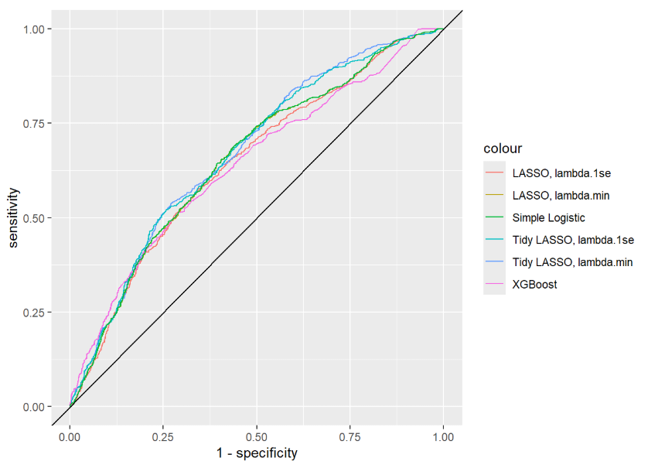
Model Performance
Model | Out-sample AUC
Simple Logistic | 0.6555515
Simple LASSO 1se | 0.6453059
Simple LASSO min | 0.6550704
Tidy LASSO 1se | 0.6695274
Tidy LASSO min | 0.6723941
XGBoost | 0.6408052
Notes:
The model performance comparison showed the tidy LASSO performed the best, so we took a look at the confusion matrix and the sensitivity and specificity of the models.

Slide 25
Model Performance
Model | Out-sample Sensitivity | Out-Sample Specificity | Out-Sample Accuracy
Tidy LASSO 1se | 0.7779 | 0.4552 | 0.5235
Tidy LASSO min | 0.6243 | 0.6094 | 0.6125
Notes:
This model is also more interpretable as it is stricter with the number of variables used and the coefficients of those variables.
We prioritised identifying true positives since our group felt the false positives identified would be filtered out by the other necessary flags.

Slide 26
Coefficients
Variable | Coefficient | Reasons
Debt to Equity | -0.0259492150 | Investors may be concerned about higher leverage
Return on Equity | 0.1458464157 | Investors may be more optimistic about higher profitability
Profit Margin | 0.0005831538 | Investors may be more optimistic about higher profitability
Current Ratio | 0.0044381229 | Higher current ratio may indicate higher financial health but includes inventory and A/R
Inventory Turnover | 0.0141108078 | Higher inventory turnover may suggest operational effectiveness
Z Score | 0.1303028750 | Higher Z score is an indicator of financial health
Restated Later | -0.0518944179 | Restatements could reflect risks discovered later

Slide 27
Coefficients
Variable | Coefficient | Reasons
Working Capital | -1.4417671928 | Working capital could be an indicator of healthy liquidity position and underutilised resources
Net Income % Change | -0.0035766419 | Positive net income percentage change can indicate sustainable growth, justifying the price
Cash Flow % Change | -0.0331688013 | Better cash flow growth indicates strong fundamentals.
Total Debt % Change | 0.0305909665 | Higher debt increase can mean higher risk
Accounts Receivables Days % Change | 0.0657267772 | Increased accounts receivable days can indicate inflated revenue and A/R
Market Cap % Change | 1.9575968849 | Higher increase of market capitalisation increases overvaluation risk

Slide 28
Model 3: Current Ratio
Notes:
recall rate, XGBoost is the better model compared to RF.
the true negatives are worse.

Slide 29
Why Current Ratio?
“Financial ratios of 16 bankrupt firms five years prior to
their bankruptcy and current ratio was a primary indicator of bankruptcy where
70% of bankrupt firms had a current ratio of one with a declining trend.” Beneish (1997)
Liquidity Risk Indicator
Low liquidity suggests that companies have difficulties servicing their short-term obligations.
Early Warning Indicator
sudden decreases in current ratios is an early sign of a company that could be on its way to financial distress.
Source: Elsayed, Ashraf, 2017
Notes:
Why did we choose current ratio?
number 1 is that current ratio is a useful liquidity risk indicator as a measure of the degree of financial distress a company faces.
Number 2 is that current ratios can act as an early warning indicator of account manipulation. Suspicion is raised when drops in the current ratio are often not followed by an improvement in firm-specific measures like sales or earnings.
Furthermore, poor current ratios is a primary indicator of the likelihood of firms going bankrupt.
Elsayed, Ashraf, Indicators of the Financial Statement Fraud (Red Flags) (November 19, 2017). Available at SSRN: https://ssrn.com/abstract=3074187 or http://dx.doi.org/10.2139/ssrn.3074187

Slide 30
Industry | Current Ratio
Drugs, Cosmetics, and Healthcare (3400) | < 1.3 | >2.5
Diversified (3410) | < 1.3 | >2.5
Cosmetics & Toiletries (3420) | < 1.2 | >2.0
Ethical Drug Manufacturers (3430) | < 1.5 | >3.0
Medical, Surgical & Dental Suppliers (3440) | < 1.5 | >2.5
Drug Store Chains (7040) | < 1.0 | > 1.8
Medical Services (8550) | < 1.2| > 2.0
Choice of Current Ratio Specific Threshold
Notes:
These are the thresholds over which a company is deemed as having poor liquidity through our research.
As standards of whether current ratios are deemed good or bad varies across different sub-industries in the healthcare sector, this separation will allow us to better identify potential manipulation of accounts among healthcare companies

Slide 31
Model Performance
Model | Out-sample AUC | Out-sample Sensitivity/Recall | Out-sample Precision | Out-sample Specificity
Simple Logistic | 58.13% | 99.88% | 75.96% | 0.2%
Fixed Effect Logistic | 54.18% | 57.68% | 66.96% | 49.83%
LASSO | 58.5% | 99.37% | 76.2% | 2%
Random Forest | 74.65% | 18.3% | 66.22% | 97.04%
XGBoost | 72.53% | 97.04% | 77.42% | 10.69%
Notes:
Comparing the AUC of the models that we ran, we find that Random Forest and XG boost have the better AUCs, but since we do not favor a high false negative rate, we focus on the recall rate or sensitivity. and since XGboost has a way higher sensitivity than RF of 97%, XGboost will be the best model.
this means that out of 100 healthcare companies that actually have unusually high current ratios, 97 of them are correctly identified as actually

Slide 32
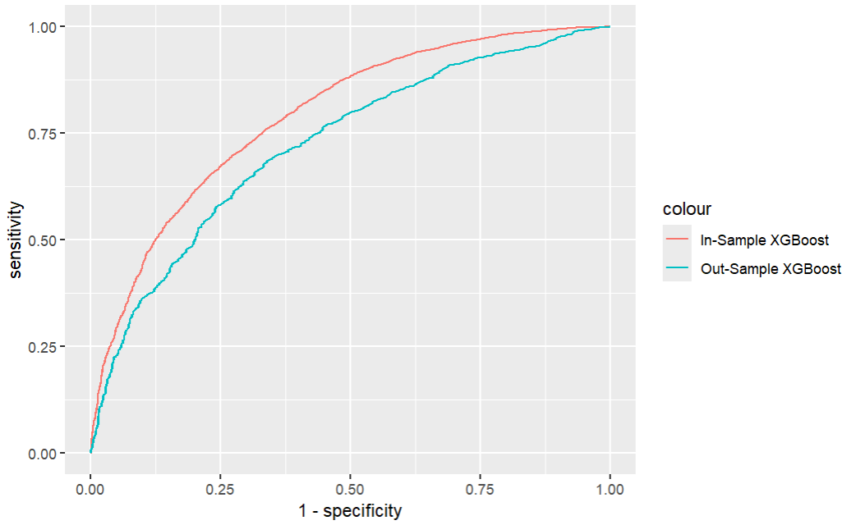
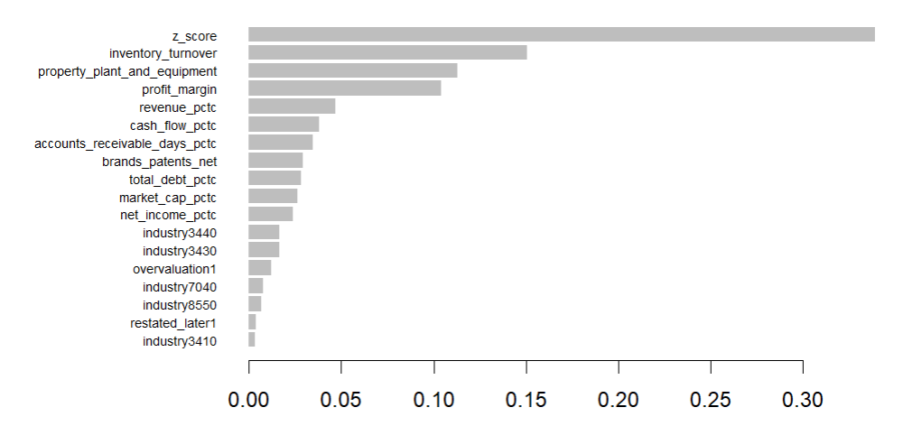
XGBoost Result
In-Sample and Out-Sample ROC Curves
XGBoost Importance Plot
Notes:
Here is a quick view of our AUC and importance plot for our XGboost model.

Slide 33
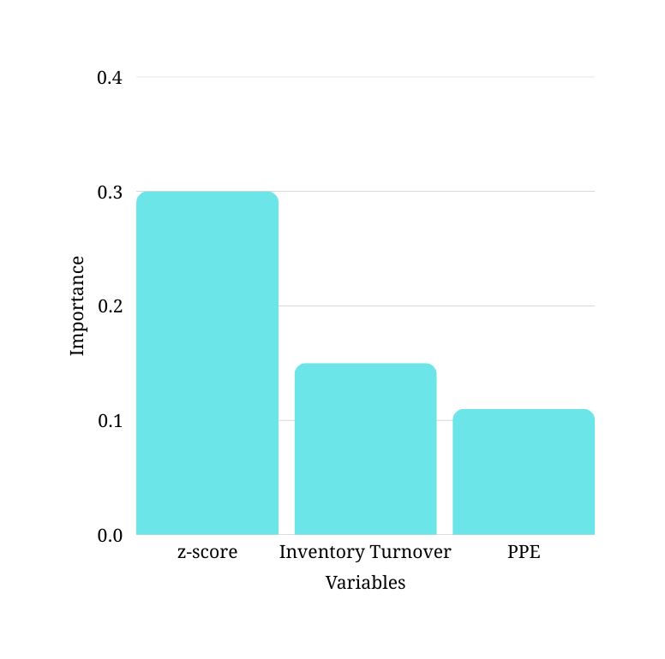
Ranking Importance
Top 3 variables
Z-score : The z-score of a company is indicative of financial distress and could be a strong predictor of an unusually high current ratio.
Inventory turnover : Low inventory turnover signals obsolete stock and hence inventory inflation. This could be a strong predictor of unusually high current ratio.
PPE : Spikes in PPE suggests capitalizing of expenses (eg. R&D, repairs) and could be a strong predictor of unusually high current ratio.
Notes:
Everything summarized,
the Z-score is an indication of potential financial distress and could be a strong predictor of unusually high current ratios
Low Inventory Turnover suggests obsolete stock and hence the potential for healthcare companies to inflate their inventories. Therefore, this could be a strong predictor of unusually high current ratios.
Lastly, high PPE spikes suggests capitalizing of expenses such as R&D and routine repairs of machinery, which could be a strong predictor of unusually high current ratio
Now I will be handing over the time to Isaac to discuss our next model.

Slide 34
Model 4: Account Restatements

Slide 35

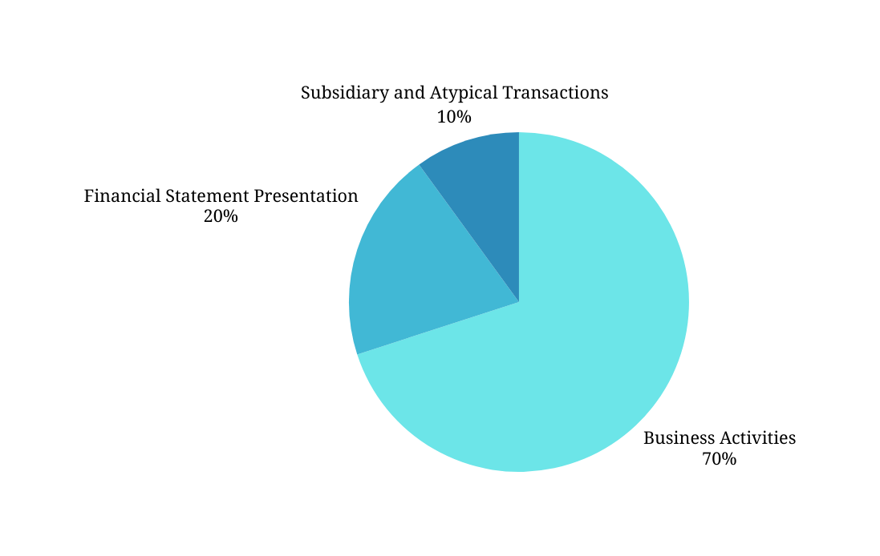
Financial Restatements
What are Financial Restatements
Most Restatements are due to business activities
Financial statement restatements occur when a company must revise previously issued financial reports due to errors or misstatements.
In practice, a restatement is a formal admission that past statements were inaccurate, and it often raises red flags about a firm’s accounting practices and internal controls
Reasons for restatements
Operational Issues: Misrecorded revenues, expenses, taxes, asset capitalization, and financing activities.
Financial Statement Presentation Errors: Incorrect classification or disclosure in financial statements, footnotes, and segment reporting.
Subsidiary and Atypical Transactions: Improper accounting related to mergers, acquisitions, consolidations, and related-party transactions.
Source: Center for Audit Quality

Slide 36
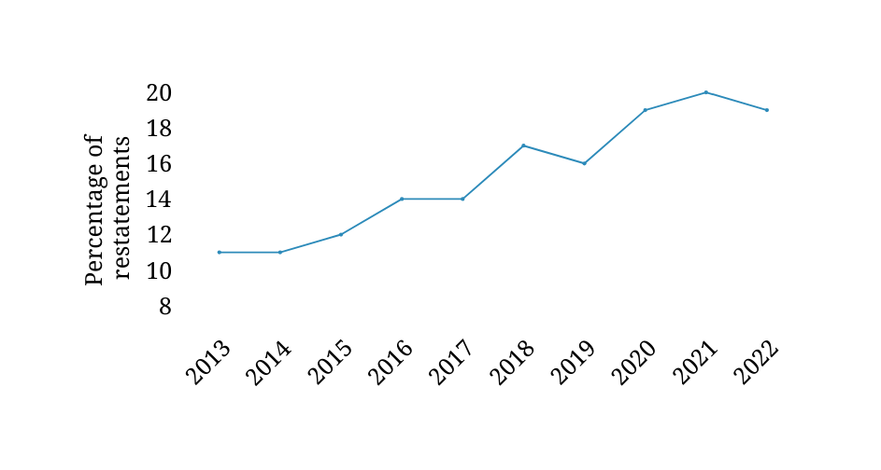
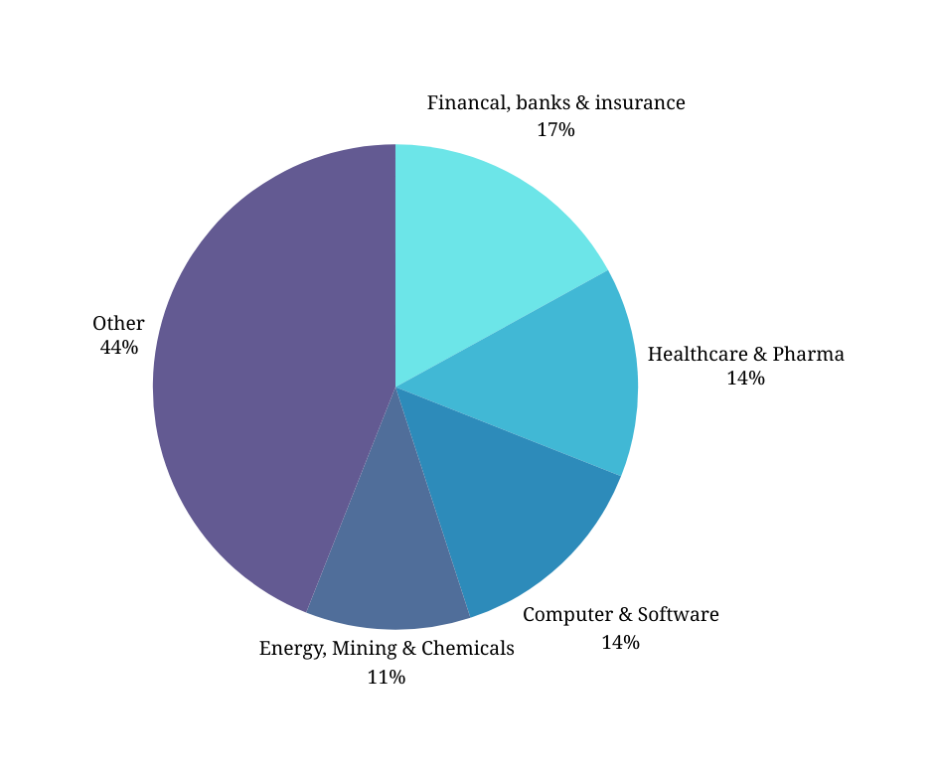

Restatements in Healthcare
Industry with 2nd most restatements
Rising Share of Restatements in Healthcare
Causes for concern
Healthcare companies are often cited with revenue recognition and inventory misstatement issues when fraud is uncovered – issues that often cause the need for restatements.
Source: Center for Audit Quality , Anti-Fraud collaboration

Slide 37

Restatements as a fraud signal
Healthcare firms are vulnerable
Case Study: WellCare Health Plans
Complex Revenue Recognition Practice:
Multiple payors and varying reimbursement terms make revenue recognition in healthcare highly judgmental and error-prone, increasing the risk of misstatements.
Dependence on accounting estimates
Reliance on subjective estimates (e.g., claims reserves, doubtful accounts) makes it easier to misstate earnings—intentionally or not.
In the mid-2000s, WellCare was required by Florida’s Medicaid programs to spend a minimum percentage of state funds on patient care, refunding any underspent amount.
2003 - 2007: $40 Million kept from Government Programs.
Restated all financial accounts from 2004-2007
High regulatory pressure
Strict compliance requirements and performance-linked funding create strong incentives for aggressive or fraudulent accounting.
Source: Center for Audit Quality , Anti-Fraud collaboration
Notes:
Fraudulent Reporting: WellCare intentionally understated medical expenses to avoid refunding approximately $40 million owed to Florida's Medicaid program, artificially inflating profits.
Financial Restatements: The fraud prompted restatements of financial results spanning multiple years (2004–2007), significantly reducing reported income and exposing underlying accounting misconduct.
Regulatory and Legal Consequences: The discovery of fraud led to severe legal actions, including fines exceeding $200 million, criminal charges, and convictions of senior executives, highlighting the serious repercussions of healthcare accounting fraud.
A striking example comes from WellCare Health Plans, a U.S. insurer specializing in Medicaid. In the mid-2000s, WellCare was required by Florida’s Medicaid programs to spend a minimum percentage of state funds on patient care, refunding any underspent amount. Under intense profit pressure, WellCare’s executives orchestrated a scheme to fraudulently understate the medical expenses so they could retain money owed back to the state​
SEC.GOV
​
SEC.GOV
. Over 2003–2007, the company illegally kept more than $40 million that should have been refunded to government programs, which inflated its reported profits by up to 13–14% in some years​
SEC.GOV
. Once this scheme came to light via a government investigation, WellCare had to restate several years of financial results (2004–2006 and part of 2007) to reduce its overstated income​
SEC.GOV
. The case highlights how regulatory requirements (in this case, spending thresholds) created an incentive for manipulation, and the subsequent restatement was indeed a glaring warning sign of fraud. Other health insurers have faced similar pressures to meet medical loss ratio targets or quality bonuses, which can lead to aggressive accounting if not outright fraud.

Slide 38
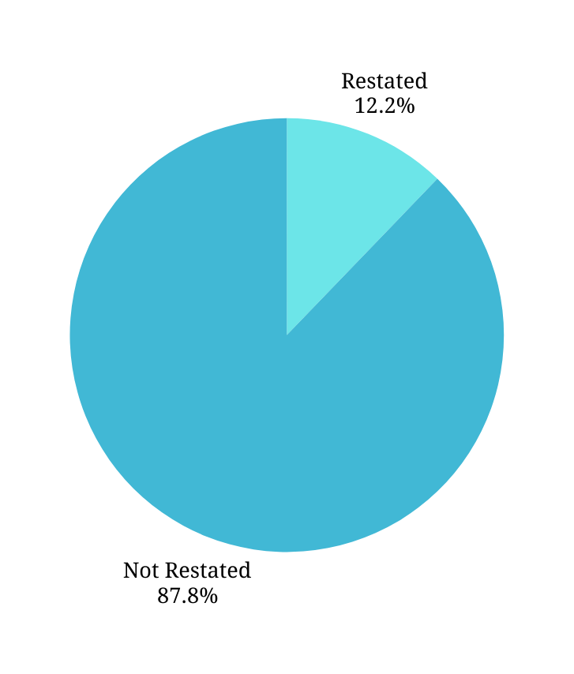
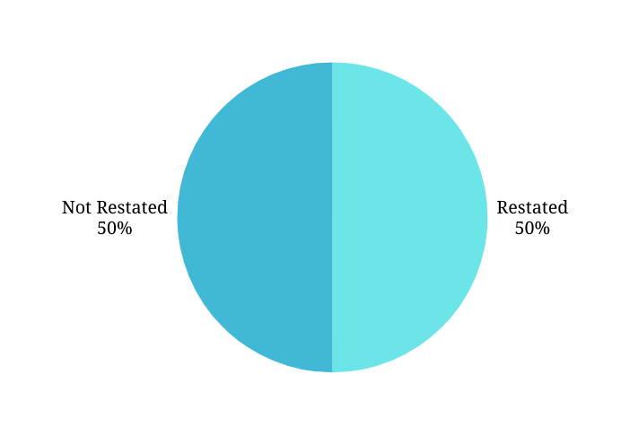
Model Construction
Significant class imbalance in dataset
Synthetic Minority Oversampling Technique (SMOTE) to balance dataset
SMOTE addresses dataset imbalance by synthetically creating new examples of the minority class, rather than simply duplicating existing ones. It interpolates between minority instances, resulting in a more balanced dataset.
Applied only to the training set, in order to prevent data leakage
Post SMOTE processing results:

Slide 39
Model Performance
Model | Out-sample AUC | Out-sample Sensitivity/Recall | Out-sample Precision | Out-sample Specificity
Simple Logistic | 0.5899 | 0.1415 | 0.7087 | 0.9102
LASSO min | 0.5902 | 0.1425 | 0.7209 | 0.9126
LASSO 1se | 0.5861 | 0.1393 | 0.7306 | 0.9104
Random Forest | 0.6427 | 0.1965 | 0.3568 | 0.9001
XGBoost | 0.6165 | 0.1627 | 0.5971 | 0.9121
Notes:
recall rate, XGBoost is the better model compared to RF.
the true negatives are worse.
Comparing the AUC of the models, we find that Random Forest and XG boost has the highest AUC, but since we are predicting the true positive cases, and XGboost has a way higher sensitivity than RF, XGboost will be the best model.

Slide 40
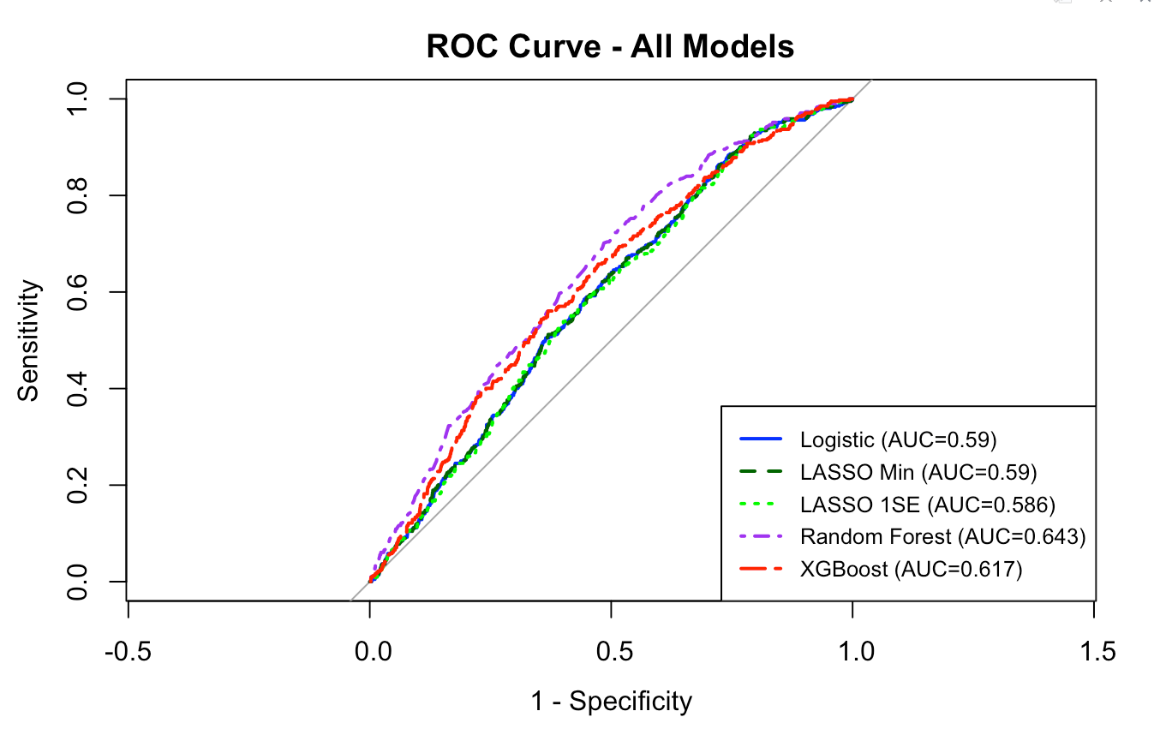
Model Performance
Notes:
recall rate, XGBoost is the better model compared to RF.
the true negatives are worse.
Comparing the AUC of the models, we find that Random Forest and XG boost has the highest AUC, but since we are predicting the true positive cases, and XGboost has a way higher sensitivity than RF, XGboost will be the best model.

Slide 41
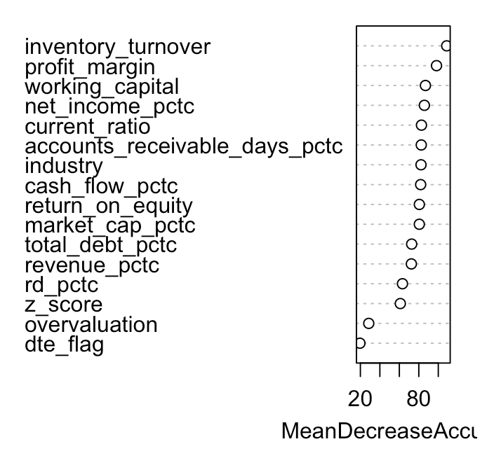
Random Forest Results
Variable Importance Plot
Top 3 variables
Inventory Turnover: High or abnormal inventory turnover may indicate aggressive revenue recognition or inventory manipulation, increasing restatement risk.
Working Capital: Extreme working capital values can mask underlying liquidity issues, potentially leading to financial misstatements.
Profit Margin: Unusually high or volatile profit margins might signal aggressive accounting practices or earnings manipulation, raising the likelihood of financial restatement.
Higher values of inventory turnover, profit margin, and working capital are the strongest indicators associated with a firm's likelihood of financial restatement
Notes:
The XGBoost importance plots the

Slide 42
Findings and
Case Studies

Slide 43
If a company is predicted as positive in 4 of our models, it will be flagged
Model | Flagged
Debt-to-Equity Ratio | ✔
Overvaluation | ✔
Current Ratio | ✔
Restatement | ✔
211 companies have been flagged
4,865 companies

Slide 44

North China Pharmaceutical Company Ltd.
A Chinese pharmaceutical enterprise specializing in the production and distribution of medications, with a focus on traditional Chinese medicine.
In May 2020, the company was fined 600,000 yuan by the China Securities and Futures Division for financial fraud and an overstatement of incomes
Examples of financial misstatements (in CNY) include:
Cash on hand overstated by 29.944 billion,
Inventory understated by 19.546 billion
Operating income overstated by 8.898 billion
Operating cost overstated by 7.662 billion
Selling expenses understated by 0.497 billion
Management expenses understated by 0.228 billion

Slide 45

Kerala Ayurveda Limited (KAL)
Indian company specializing in the manufacturing and sale of Ayurvedic products, including therapeutic formulations, health supplements, skin and beauty care products, and specialty foods.
In February 2020, Tata Global Beverages Limited (TGBL) alleged that KAL defaulted on a financial debt amounting to ₹42.5 million (S$684,000). The National Company Law Tribunal (NCLT) acknowledged this claim.
In May 2023, the Kerala Financial Corporation filed an Insolvency and Bankruptcy Code application against KAL, citing claims totaling approximately ₹286.4 million (S$4.64 million).

Slide 46
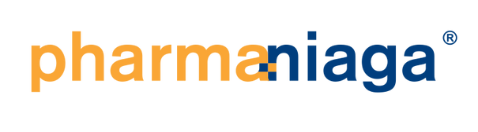
Pharmaniaga Berhad
A pharmaceutical company based in Malaysia.
In 2022, an independent audit by PwC showed that it was facing serious financial challenges.
The group's short-term debts surpassed its short-term assets by RM632.1 million, while the company reported a negative equity position of RM227.4 million.
Large impairment of unsold COVID-19 vaccines worth RM552.3 million resulted in the group net loss amounting to RM85.47 million and sinking share price by 50%
These concerning financial indicators suggest Pharmaniaga may struggle to remain operational unless it undergoes restructuring or receives external financial assistance.

Slide 47
7. Limitations

Slide 48



Limitations
Many rows of missing dataset, winsorization had to be done to reduce NA.
Healthcare companies from various countries, which are subject to different accounting standards and strictness in enforcement
Many companies are part of larger conglomerates, resulting in reduced transparency as well as multinational transfers of revenue and losses to reduce tax liabilities

Slide 49
Thank you!
Q&A

Slide 50
Appendix

Slide 51

IndoFarma Tbk PT
State-owned manufacturer of medical supplies and medicines in Indonesia.
The financial manipulations involved their subsidiary, IndoFarma Global Medika. Indofarma's financial problems were triggered by its subsidiary, PT Indofarma Global Medika (IGM), which led to state losses of Rp371.83 billion (US$23 million).
Manipulated financial reports, which includes "window dressing" to improve the appearance of its financial health, involving the recording of fictitious sales, leading to substantial losses.

